Slide 1
User Interfaces for
Embedded Systems
Presentation 6:
Design Guidelines & Heuristics

Slide 2
Cognitive Psychology HCI
The Human Mind as an information processor
  The Human Body as input/output
  Hard Science
  Distilled experiences: Guidelines & Heuristics
  Method: Heuristic Evaluation

Slide 3
Usability Heuristics
Avoid common design pitfalls by following design principles: guidelines & heuristics
Inspect an interface for usability problems with these principles (Heuristic evaluation)

Slide 4
Design principles
Broad usability statements that guide a developer’s design efforts
  use the users language
  provide feedback…
Derived from common design problems
across many systems and
many researchers and
developers experiences
= Patterns of Usability

Slide 5
Available guidelines
General guidelines
  Shneiderman’s 8 Golden Rules of Interface Design
  Nielsen’s 9 principles of design
  Normans 4 principles of good design
  Molich’s 5 guidelines for screen dialogs
  MANY OTHERS – look for yourselves at ACM and Cite Seer
Area specific guidelines
  Agricultural
  Mobile / Office Workers
  Leisure activities (designing for the home)
  Designing for the hospital / nursing home
Technology/Platform specific guidelines
  Windows, touchscreen, web, smart phone, tablets

Slide 6
Usability Patterns
Usability Patterns are emerging
Relates to many of the same issues
Has design scope – not review

Slide 7
General Guidelines & Heuristics
Guidelines = Heuristics = Experiences
We will be looking at Nielsen’s 9 guidelines next
Guidelines are easy to understand, so I will not spend time introducing you to them in detail – please read
Remember: be critical

Slide 8
Usability Engineering – Jakob Nielsen
Nine principles of design
  Simple and natural dialog
  Speak the user’s language
  Minimize user’s memory load
  Be consistent
  Provide feedback
  Provide clearly marked exits
  Provide shortcuts
  Deal with errors in a positive manner
  Provide help
Heuristic Evaluation, method for evaluating and interface
Revised list includes 10 heuristics – see page 506 in ID-book)
Fairly coarse
grained model

Slide 9
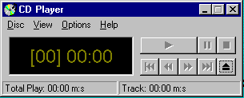
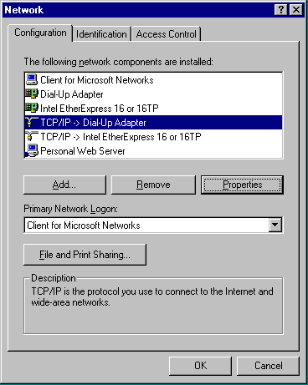
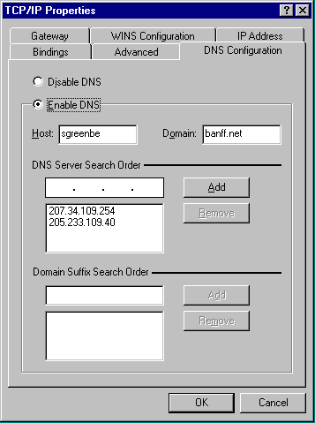
1. Simple and natural dialogue
  use the user’s conceptual model
  match the users’ task sequence
  minimize mapping between interface and task semantics
Only display what is
Useful for the current task
From Microsoft applications

Slide 10
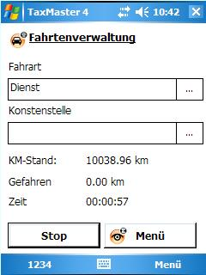
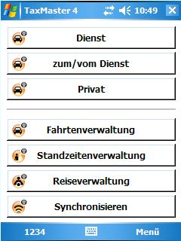
1. Simple and natural dialogue
Present exactly the information the user needs
  less is more
    less to learn, to get wrong, to distract...
  information should appear in natural order
    related information is graphically clustered
    order of accessing information matches user’s expectations
  remove or hide irrelevant or rarely needed information
    competes with important information on screen
  remove modes
Redesigned from 5 clicks to 1 + more natural mapping.
All daily tasks were mapped to main screen

Slide 11

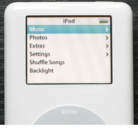
1. Simple and natural dialogue
Microsoft Inductive User Interface Guidelines
Deductive
  Deduce: to conclude by reasoning
  The user must deduce from interface “What do I have to do here?”
  Bad user mental model support
Inductive
  Induce: to lead or move by influence or persuasion
  Split dialogs into simple task atomic units that only have one purpose
  Less is more principle

Slide 12

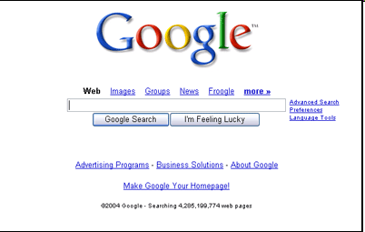
1. Simple and natural dialogue
UI Pattern: Clear Entry Points:
  http://designinginterfaces.com/Clear_Entry_Points

Slide 13
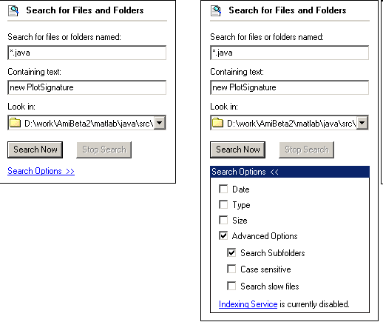
1. Simple and natural dialogue
UI Pattern: Extras on Demand
  http://designinginterfaces.com/Extras_On_Demand

Slide 14
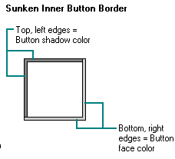
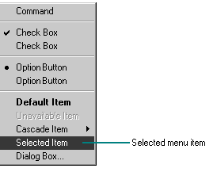
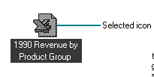
Design Guidelines for Windows
Excerpts from Microsoft on “Visual Design”:
  http://msdn2.microsoft.com/en-us/library/ms997613.aspx
Color:
  Some percentage of the population may have color-identification problems. This can affect the accessibility of your software to the widest possible audience. For example, about 9 percent of the adult male population have some form of color confusion.
Access Keys:
  Always define an access key for the label of any control or menu item. The only exceptions are the OK and Cancel buttons because the ENTER and ESC keys typically serve as the access keys to these buttons. Also, avoid having the same access key used by more than one control in a single context or more than one item on the same menu.
Animation:
  Avoid gratuitous use of animation. When animation is used only for a decorative effect, it can distract or annoy the user. To use animation most effectively, use it for a specific purpose or condition. Avoid repeating the animation unless the condition persists or reoccurs. You should provide the user with the option of turning off the animation or otherwise customizing the animation effects.

Slide 15

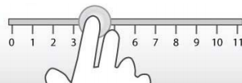
Touchscreen Guidelines
1) Use “natural” interaction devices
2) Size interactive elements adequately
3) Keep wandering hands in mind
4) Forget hovering and ToolTips
5) Optimize textual inputs
Excerpts from http://www.progea.us/guide-to-software-usability-principles

Slide 16
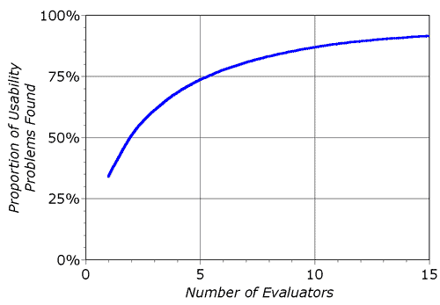
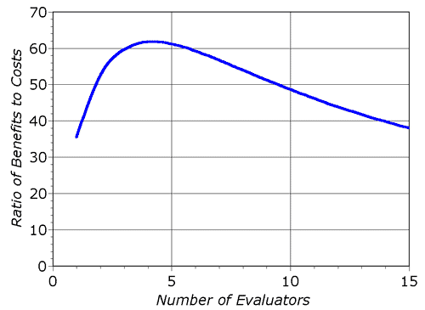
Heuristic Evaluation
Systematic inspection to see if interface complies to guidelines (could be these 9 – and/or others)
Method
  3-5 inspectors
  usability engineers, end-users, double experts…
  inspect interface in isolation
  ~1–2 hours for simple interfaces
  compare notes afterwards
    single evaluator only catches ~35%
    of usability problems
    5 evaluators catch 75% (nielsen)
Works for paper, hi-fi prototypes,
and working systems

Slide 17
Heuristic Evaluation Guide
Briefing session
  Which interfaces & tasks to evaluate
  Usage scenario
  Which Heuristics to use
Evaluation period
  Each evaluator is on his own for 1-2 hours
  Two passes of checks using the heuristics
  Record all problems
Debriefing session
  Evaluators come together to discuss findings, prioritize the problems and suggest solutions

Slide 18
Heuristic Evaluation Advantages
Advantages:
  “Minimalist” approach
    a few guidelines identify many common usability problems
    easily remembered, easily applied with modest effort
  Discount usability engineering / Gurillia HCI
    end users not required
    cheap and fast way to inspect a system – or even mock-up
    can be done by usability experts, double experts, and end users

Slide 19
Heuristic Evaluation Drawbacks
Drawbacks:
  Can’t be treated as a simple checklist
  Subtleties involved in their use
  Evaluators might not understand the domain
  For every 1 problem found, 1 false alarm and ½ is missed (preece et al.)

Slide 20
Mini Project
Review the 10 Jakob Nielsen heurstics (see page 506-507)
Use the 10 guidelines (heuristics) with the 5 touch screen guidelines
Consider adding other guidelines you can find
Make a checklist
Perform heuristic evaluation on your two prototypes
Let the members of your peer group split up in two teams, where each team inspects one of your prototypes
Compare the two prototype evaluation reports made in your group with the reports made by your peer group. Write a ½ page report and prepare a 5 minute presentation. Which of the prototypes contained the most errors? What was the error about? Did different observers find the same problems when going through the checklist?

